Slide 1

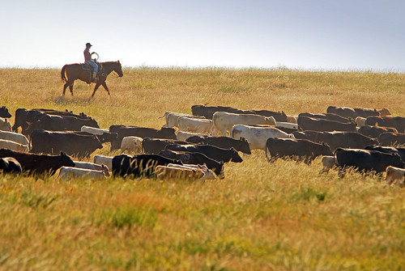
Foreign Influence Requirements Roundup
Agency by Agency Current Expectations Plus A Sneak Peek at What we Think is Coming
Jim Luther, Associate Vice President Finance & Compliance Officer
Duke University
James.luther@duke.edu
Pamela Webb, Associate Vice President for Research
University of Minnesota
pwebb@umn.edu

Slide 2
Goals for Today..
With the wealth of information constantly coming out (or being promulgated) related to foreign influence issues, concerns – and requirements that agencies need to impose to address those concerns – it can be hard to keep up with what research administrators need to comply with.
This webinar will include:
pragmatic snapshot of the national picture
what requirements exist TODAY from various federal agencies related to foreign influence and related national security issues
what is most likely (but no promises!) heading our way in the coming months.
Some research administrators already deeply embedded in foreign influence issues may not learn anything new; for the rest of us, this will allow an opportunity to “catch up” or confirm the current interpretation of the guidance as well as having an idea of what requirements or legislation may be bubbling up in this space in the coming months.

Slide 3




The National
Picture
DOD, DOE,
NASA, Ed,
Energy
Institutional
Challenges
Coming Attractions

Slide 4

Francis Collins August 23, 2018 Letter
NIH pledge to:
Improve accurate reporting of all sources of research support, financial interests, and affiliations
Mitigate the risk to intellectual property security while continuing collaborations
Explore additional steps to protect the integrity of peer review

Slide 5
Foreign Influence Timeline
Integrity of Research
Increasing harmonization / Increasing Enforcement / Conflation with Broader Economic & Political Issues
National / Economic Security
August 2018
Winter / Spring 2018/19
Summer / Fall 2019
Winter - Summer 2019/20
Awareness
Understanding & Increased Risk Acknowledgement
Agency Clarifications & University Interpretation
Agency Implementation & Continued Enforcement & Harmony

Slide 6

Foreign Influence Timeline
Integrity of Research
Increasing harmonization / Increasing Enforcement / Conflation with Broader Economic & Political Issues
National / Economic Security
August 2018
Winter / Spring 2018/19
Summer / Fall 2019
Winter - Summer 2019/20
Awareness
Understanding & Increased Risk Acknowledgement
Agency Clarifications & University Interpretation
Agency Implementation & Continued Enforcement & Harmony
NIH Letter
Foreign
Component /
Foreign Influence
Disclosure
Other Support
(NIH / NSF)
National Security, Economic Security, Integrity of Research
Diversion of intellectual property (IP) in grant applications
Sharing of confidential information during peer review
Failure to disclose substantial resources
Affiliations & appointments
Include non-financial support
Talent Programs
Other Inclusions?
“Significant”
Outside of U.S.
OSTP Communication: “Enhancing the Security and Integrity of America’s Research Enterprise”
Sponsor Communication & Implementation
FBI
Congressional Activity
Increased Harmonization
NIH: Letters to Universities & ACD
NSF – JASON, Etc.
DoD – National Security
December 2019
Congressional Interest
JASON Report
JCORE – Joint Comm. on Research Environ.

Slide 7

China’s Thousand Talents Program
In 2008, the Chinese Communist party (CCP) announced the Thousand Talents Plan (TTP), which was designed to recruit 2,000 high-quality foreign professionals within five to ten years.
By 2017, the program had lured 7,000 foreigners — more than triple its target. As part of a broad push to achieve global technological supremacy, China has committed 15 percent of its GDP — equivalent to $2.1 trillion in 2019 — to human-capital development.
from https://www.nationalreview.com/2020/02/charles-lieber-case-why-american-scientists-take-chinese-money/

Slide 8

Talent Programs – What’s the Issue?
Receive from the Chinese Govt:
Significant salary
Appointment at a foreign university
Funded “Shadow” lab in China
Access to high tech equipment
And in return may include one or more:
Commitment to keep the terms of the agreement confidential
Do not disclose the results of work conducted under Chinese patronage
Turn over any intellectual property that they develop (in US or in China)
Require permission of the Chinese government to terminate the agreement
Provide appointments in the US lab to Chinese collaborators or visitors

Slide 9

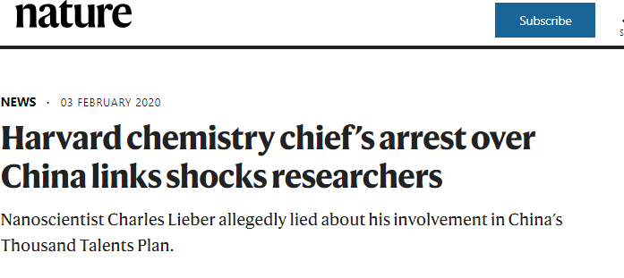
“Several Moffitt faculty cited the personal participation of Moffitt leadership in the Talents …as a reason for their own agreement to participate.”
“… they failed to disclose the existence of personal bank accounts in China in which the unreported funds were deposited.”
“.. But the report also suggests several Moffitt scientists were scamming their Chinese funders by not putting in the time they had promised under their Thousand Talents deals.”

Slide 10
OSTP – JCORE Report and Actions
OSTP clearly defines the foreign influence problem
OSTP establishes harmonized actions for agencies
OSTP releases “best practice” for universities
OSTP: Office of Science & Technology Policy
JCORE: Joint Committee on the Research Environment – White House Summit
JASON Report: Fundamental Research Security
Kelvin Droegemeier
speech for the FDP on
June 23, 2020
Coming soon (now +- 6 mos)

Slide 11
Thought Exchange
(from August FDP event)
“Given the recent federal communications and regulatory updates, what are the most pressing concerns and questions that you have in this space?
Link to FDP Recording

Slide 12
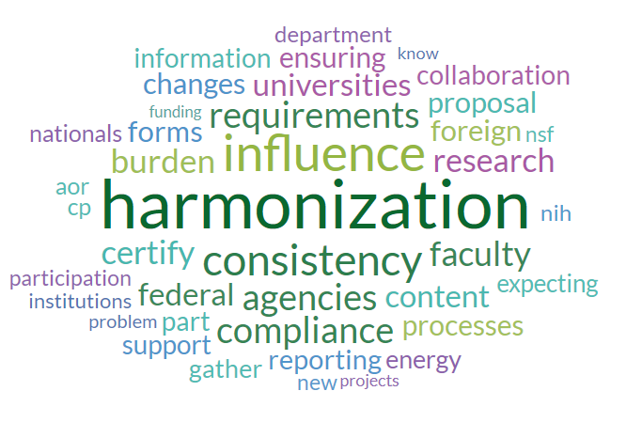
Word Cloud – Areas of Interest
Word Size → Frequency
Word Color → Related Words

Slide 13
Themes
Harmonization
  Need standardized guidance
  Data fields/forms should be harmonized across agencies
  Reduce administrative burden on researchers while improving accuracy of content.
Definitions
  Crisp and unambiguous definitions agreed to by all stakeholders
  Examples: foreign talent program, baseline for 100% time, research “activities”
Institutional Role / Outside Appts
  University versus investigator responsibilities for accuracy and completeness
Confusion around FCOI reporting and Other Support reporting

Slide 14


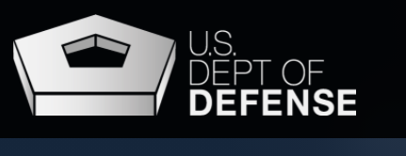
AGENCY REQUIREMENTS

Slide 15

China Restriction

Slide 16
NASA Restriction on Chinese Participation
(Section 1340 of PL 112-10, Section 539 of PL 112-55) and earlier (2012) guidance
(From NASA Grants Management Handbook):
C3. ..By submission of its proposal, the proposer represents that the proposer is not China or a Chinese owned company, and that the proposer will not participate, collaborate, or coordinate bilaterally with China or any Chinese-owned company, at the prime recipient level or at any subrecipient level, whether the bilateral involvement is funded or performed under a no- exchange of funds arrangement.
NOTE: Use of NASA funds to support Chinese national students or visiting scholars is not expressly forbidden, but the restriction is focused on the existence of the individual’s affiliation with the government of China or a Chinese-owned company.

Slide 17


Current and Pending
Biosketch
In-Kind Contributions
Post-Award Notification

Slide 18
NSF Current and Pending
From June 2020:
  “Current and pending support includes all resources made available to an individual in support of and/or related to all of his/her research efforts, regardless of whether or not they have monetary value. Current and pending support also includes in-kind contributions (such as office/laboratory space, equipment, supplies, employees, students. In-kind contributions not intended for use of the project/proposal being proposed also must be reported. Current and pending support information must be provided for this project, for ongoing projects, and for any proposals currently under consideration from whatever source, irrespective of whether such support is provided through the proposing organization or is provided directly to the individual.”

Slide 19
Current & Pending Tips
NSF FAQS (6/30/20)
True” outside consulting need not be reported
  Exception: report research being conducted under a consulting agreement
Start Up Packages from proposing organization need not be reported
  Start Up packages from all other organizations must be.
Mentoring done at the proposing institution within the regular appointment (no external funding/time) need not be reported
Report only the research endeavors of an individual for whom the report is being made (not all the research in that person’s lab)
  NSF FAQ #11 in part states: “Research endeavors” in the context of the guidance provided in PAPPG Chapter II.C.2.h. does refer to the endeavors of the particular individual.”
NSF approved “format” must be used starting 10/5/20
  Guidance Page
  ScienCV
  NSF’s Fillable PDF

Slide 20
NSF Updates to the Research Performance Progress Report (RPPR) - Effective 10/5/20
Jean Feldman (Head, Policy Office): 9/28/20 E-mail
New Question for Project Reports with Active Other Support Changes
  Has there been a change in the active other support of the PI/PD(s) since the last reporting period?
Additional New Questions from the Revised RPPR
  What was the impact on teaching and educational experiences? (Impact tab);
  What percentage of the award’s budget was spent in a foreign country? (Impact tab); and
  Has there been a change in primary performance site location from that originally proposed? (Changes/Problems tab).

Slide 21
So we DO have to report ..
The lab space our investigator has in a foreign country
The research funding the investigator gets personally or through another professional appointment (as well as his/her institutional appointment)
The material or data provided by a third-party for use in our investigator’s research
The access to postdocs, students, technicians donated by a third party for use in our investigator’s research
Support our investigator receives from an external source to mentor a research postdoc conducting our investigator’s research
Activities that happen outside the appointment (e.g. summer months for 9 month faculty)
AND who is responsible for the content of the Current & Pending documents?

Slide 22
NSF Post-Award Disclosure
NSF Article 38: Post-award Disclosure of Current Support and In-Kind Contribution (effective on awards/increments issued 10/5/20 or later)
Establishes a post-award disclosure requirement of undisclosed current support and in-kind contribution information. If an organization discovers that a PI or co-PI on an active NSF award failed to disclose current support or in-kind contribution information as part of the proposal submission process, the AOR must submit the information outlined in the article within 30 calendar days of the identification of the undisclosed current support or in-kind contribution
PI/co-PI Name: • Project Title: • Award Number (if available): • Source of Support: • Primary Place of Performance: • Project Start and End Date: • Total Award Amount (including Indirect Costs): $ • Brief Description of the Major goals of the project: • Description of any Overlap/Duplication of the project with the NSF award: • Impact on the ability of the PI/co-PI to carry out the NSF award: • Person-Month(s) (or Partial Person-Months) Per Year Committed to the Project

Slide 23

Data
Other Support
Biosketch
Foreign Component

Slide 24
The Extent of the Problem..
399 NIH Researchers were identified
70% failed to disclose the receipt of a foreign grant
54% failed to disclose participation in a foreign talent recruitment program
9% hid ties for a foreign company
5% involved violation of NIH’s peer review system
189 NIH-funded scientists at 87 institutions have been sanctioned either by NIH or by their employer
77 investigators have been blocked from applying for a new NIH grant
Source: SCIENCE – By Jeffry Mervis Jul. 14, 2020 , 12:00 PM

Slide 25
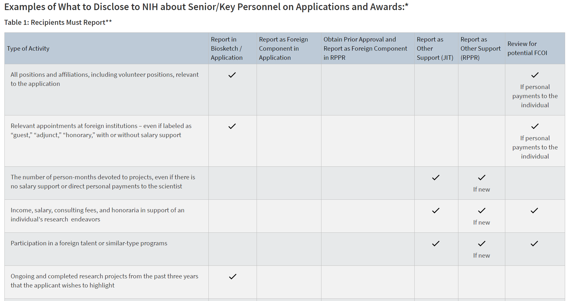
NIH Protecting U.S. Biomedical Intellectual Innovation
Helpful chart about what to disclose where
[Excerpt only is shown here]

Slide 26
NIH Protecting U.S. Biomedical Intellectual Innovation
Includes
  Applicant and Recipient Institution Responsibilities
    Work with faculty and other staff to make sure that all applications, progress reports, … include an accurate and complete account of all sources of research support, and relevant affiliations for individuals named as senior/key personnel
    Ensure that all reports and communications submitted to NIH are complete and accurate
  NIH Responsibilities
  FAQs
  Related Guide Notices

Slide 27

Foreign Component
Reminders of NIH Policies on Other Support and on Policies related to Financial Conflicts of Interest and Foreign Components (Notice Number: NOT-OD-19-114)
Performance of work by a researcher or recipient in a foreign location,
Significant – Examples (from FAQs)
  collaborations with investigators at a foreign site anticipated to result in co-authorship
  use of facilities or instrumentation at a foreign site
  receipt of financial support or resources from a foreign entity

Slide 28
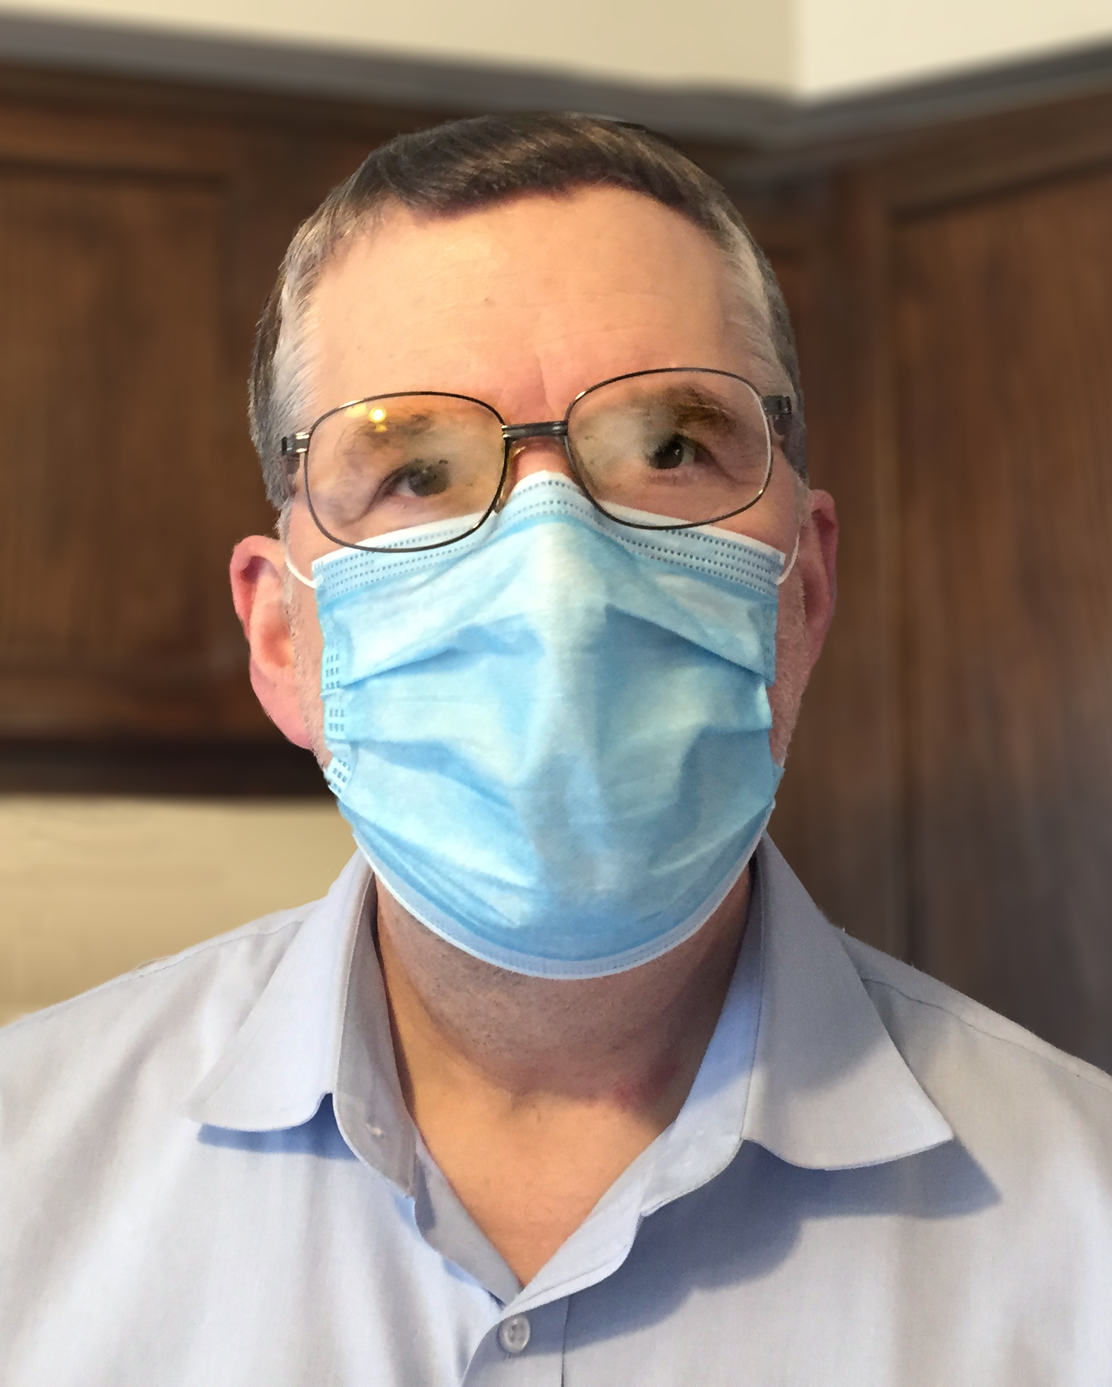
“Principled International Collaborations”?
Undisclosed foreign employment,
Undisclosed obligations to generate foreign patents that may be related to NIH-funded work,
Undisclosed preferential treatment in American laboratories for certain students or visiting scientists,
Undisclosed research support – often for similar if not identical research being supported by the NIH,
Undisclosed compensation deposited into secret foreign bank accounts,
Undisclosed obligations to assign credit to foreign institutions for work done largely in the U.S.,
Undisclosed obligations to keep foreign arrangements and scientific work secret,
Undisclosed obligations to transfer propriety information and technologies to foreign institutions,
Stringent restrictions on termination of contract,
Undisclosed significant financial conflicts of interest, and
Egregious violations of peer review confidentiality rules.
Open Mike: Addressing Foreign Interference and Associated Risks to the Integrity of Biomedical Research, and How You Can Help

Slide 29
Foreign Talent Recruitment Program Definition
Special Clauses
Foreign National Approval Form

Slide 30
Dept. of Energy
DOE Order 486.1, Department of Energy Foreign Government Talent Recruitment Programs
  Employees on DOE contracts or subcontracts can’t participate in a foreign government talent program from a foreign country of risk (currently, China, Iran, North Korea, and Russia) if they are working in DOE owned or leased facilities. Quarterly reports required.
DOE Order 486.1A, FOREIGN GOVERNMENT SPONSORED OR AFFILIATED ACTIVITIES (9-4-20)
  Defines “Foreign Government-Sponsored Talent Recruitment Program”
  Information on “In-kind”, “Other Support”, “Positions and Appointments”, etc.
  “This further includes compensation, for example, current or promises of future: grants, awards, funding, scholarship, appointment, sabbatical, travel, university directed funding, and honoraria.”
DOE O 142.3A, Unclassified Foreign Visits and Assignments Program
  December 2019 change removes the exception previously in place to declare DOE grants exempt from needing approval to involve foreign nationals doing work at non-DOE facilities

Slide 31
Foreign Talent Recruitment Program Definition
Included in DOE O 486.1a FOREIGN GOVERNMENT SPONSORED OR AFFILIATED ACTIVITIES
Core Definition (Excerpt):
Foreign Country of Risk. Any foreign country determined to be of risk, following consideration of, but not limited to, the Office of the Director of National Intelligence WorldWide Threat Assessment and The National Counterintelligence Strategy of the United States of America, by the Under Secretary for Science in consultation with the Under Secretary of Energy; the Under Secretary for Nuclear Security; and the Office of Intelligence and Counterintelligence.
Foreign Country of Risk Sponsored or Affiliated Activity. Any foreign government sponsored talent recruitment program or other foreign government sponsored or affiliated activity, as defined below, of a Foreign Country of Risk.
Distinguishing features:
An effort directly or indirectly organized, managed, or funded by a foreign government to recruit science and technology professionals or students (regardless of citizenship or national origin, and whether having a full-time or part-time position).
… operate with the intent to import or otherwise acquire from abroad, sometimes through illicit means, proprietary technology or software, unpublished data and methods, and intellectual property to further the military modernization goals and/or economic goals of a foreign government.
… aim to incentivize the targeted individual to physically relocate to the foreign state for the above purpose. Some programs allow for or encourage continued employment at U.S. research facilities or receipt of Federal research funds while concurrently working at and/or receiving compensation from a foreign institution, and some direct participants not to disclose their participation to U.S. entities.
Compensation could take many forms including cash, research funding, complimentary foreign travel, honorific titles, career advancement opportunities, promised future compensation, or other types of remuneration or consideration, including in-kind compensation.

Slide 32
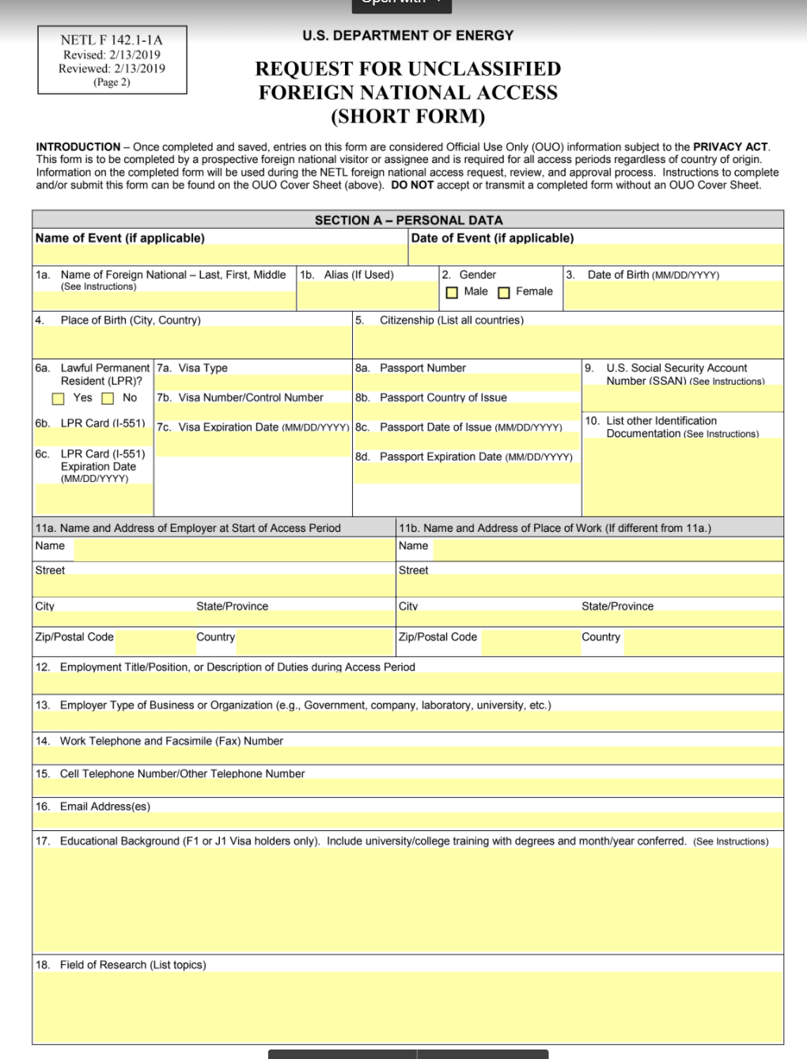
Obtaining Approval for a Foreign National
Now appearing on new and modified DOE awards (including a no cost time extension!)
A “foreign national” is defined as any person who is not a U.S. citizen by birth or naturalization.
Must submit Form 142-1A plus passport, visa or lawful permanent residency proof, and a CV
Prior DOE approval is required before the individual can work on the project (except for existing awards, where the form must be submitted within 30 days of the term being added to the award)

Slide 33
Polling Questions:
Have you received a DOE award with this requirement?
Yes
No
I have no idea – I hope not
If you have submitted a foreign national approval request, what was your response experience?
Pending - fewer than 30 days since submission
Pending - more than 30 days since submission
Approved within 30 days
Approved but took longer than 30 days
Disapproved within 30 days
Disapproved but took but longer than 30 days

Slide 34
Other Support
CMCC
NDAA 889

Slide 35
DOD Other Support Now Requested Consistently
DoD Memorandum titled “Actions for the Protection of Intellectual Property, Controlled Information, Key Personnel and Critical Technologies (March 2019)
Senior/Key Person Form in all FOAs for research and research-related educational activities must require all senior/key persons to report:
A list of all current projects the individual is working on, in addition to any future support the individual has applied to receive, regardless of the source.
Title and objectives of the other research projects.
The percentage per year to be devoted to the other projects.
The total amount of support the individual is receiving in connection to each of the other research projects or will receive if other proposals are awarded.
Name and address of the agencies and/or other parties supporting ing the other research projects.
Period of performance for the other research projects.

Slide 36

CyberSecurity Maturity Model Certification
Will soon be required for all DOD contractors and subcontractors
Requirement to safeguard all controlled unclassified information (CUI) and federal contract information (FCI)
Requirement to undergo an assessment of your digital infrastructure and security practices by a CMMC Third Party Assessment Organization (C3PAO)
Levels ranging from Level 1 (core good business practice security) to Level 5 (too secret to describe)
Will start appearing in some RFPs this fall (must have a certificate to propose, but it is unclear whether that will happen now)

Slide 37
2019 NDAA Section 889 Telecommunications Equipment
Information Page (with FAQs and Summary)
Part A: Effective August 13, 2019, the Government may not obtain (through a contract or other instrument) certain telecommunications equipment or services produced by five named Chinese companies or their subsidiaries and affiliates ●
Part B: Effective August 13, 2020, the Government may not contract with an entity that uses certain telecommunications equipment or services, as a substantial or essential component of any system, or as critical technology as part of any system, produced by any of the same five named Chinese companies or their subsidiaries and affiliates ○
  Use is “regardless of whether that use is in performance of a Federal contract”
5 companies are: Huawei, ZTE, Hytera, Hikvision, and Dahua and their subsidiaries (and others “owned or controlled by, or otherwise connected to,” the PRC

Slide 38
Regulatory Confusion
NDAA 889(b)
UG 200.216
  “To implement this requirement, OMB is adding a new section, 2 CFR 200.216 Prohibition on certain telecommunication and video surveillance services or equipment, which prohibit Federal award recipients from using government funds to enter into contracts (or extend or renew contracts) with entities that use covered telecommunications equipment or services. This prohibition applies even if the contract is not intended to procure or obtain, any equipment, system, or service that uses covered telecommunications equipment or services.”
Interim Rule submitted by GSA/NASA/DoD

Slide 39
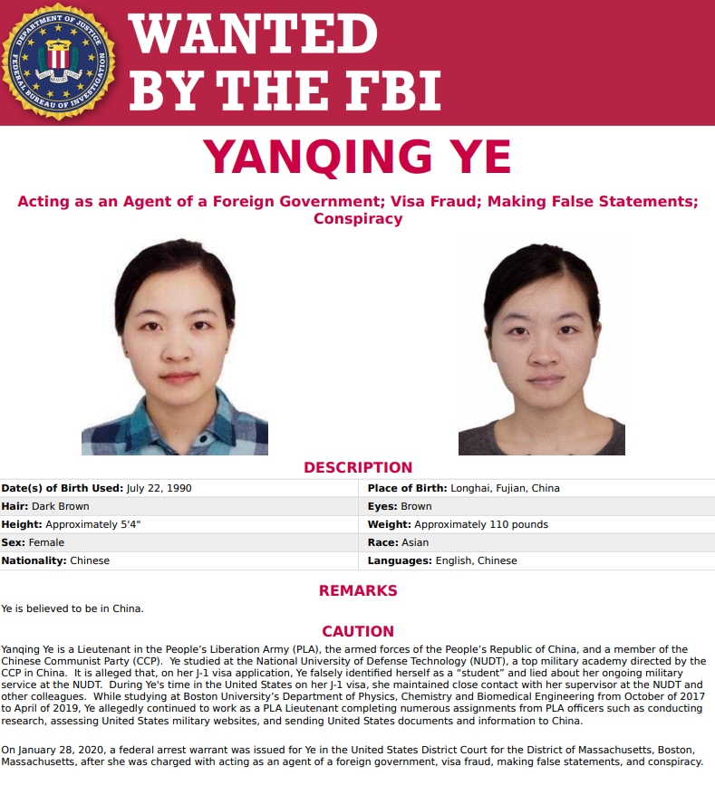
FBI
Counter Intelligence Bulletin (02 September 2020): China’s People’s Liberation Army (PLA) Continues to Abuse US Intellectual Freedom to Advance Its Military Capabilities
Flash (24 August 2020): Tactics, Techniques, and Procedures Associated with Malware within Chinese Government-Mandated Tax Software
PSA (16 July 2020): Foreign Government-Sponsored Talent Recruitment Plans, such as China’s Talent Plans, Incentivize Economic Espionage and Theft of Trade Secrets
Counterintelligence
  News
  Most Wanted

Slide 40
Congressional Activity
Portman Bill
  ‘‘Safeguarding American Innovation Act’’
Committee on Oversight and Reform
  May 4, 2020 Letter to Secretary DeVos - unreported foreign direct investment into the U.S. higher education system
Visas issues…

Slide 41
Student/ VISA Issues (9/24/20)
DHS Proposes to Change Admission Period Structure for F, J and I Nonimmigrants
The Notice of Proposed Rulemaking, Establishing a Fixed Time Period of Admission and an Extension of Stay Procedure for Nonimmigrant Academic Students…proposes to remove the duration of status framework that currently allows aliens in F, J and I classifications to remain in the United States for as long as they maintain compliance with the terms of admission.
  …preventing foreign adversaries from exploiting the country’s education environment; and properly enforcing and strengthening U.S. immigration laws.”
  Under the proposed rule, F or J nonimmigrants would be admitted into the United States for a period up to the end date of their program, not to exceed four years, unless DHS determines that the nonimmigrant is subject to a shorter period of authorized stay limited to two years. Aliens from countries associated with high visa overstay rates (rates greater than 10% for student and exchange visitors) will be limited to up to a two-year fixed period of stay to increase monitoring, deter immigration violations and incentivize timely departure.
  Additional factors that may trigger a two-year period of authorized stay include an alien’s birth or citizenship from a country on the State Sponsors of Terrorism list; whether a school or program sponsor is an E-Verify participant in good standing; and, for F nonimmigrants, whether a school is accredited by an accrediting agency recognized by the Secretary of Education

Slide 42
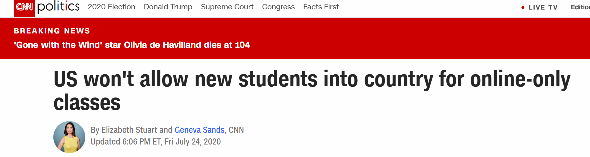
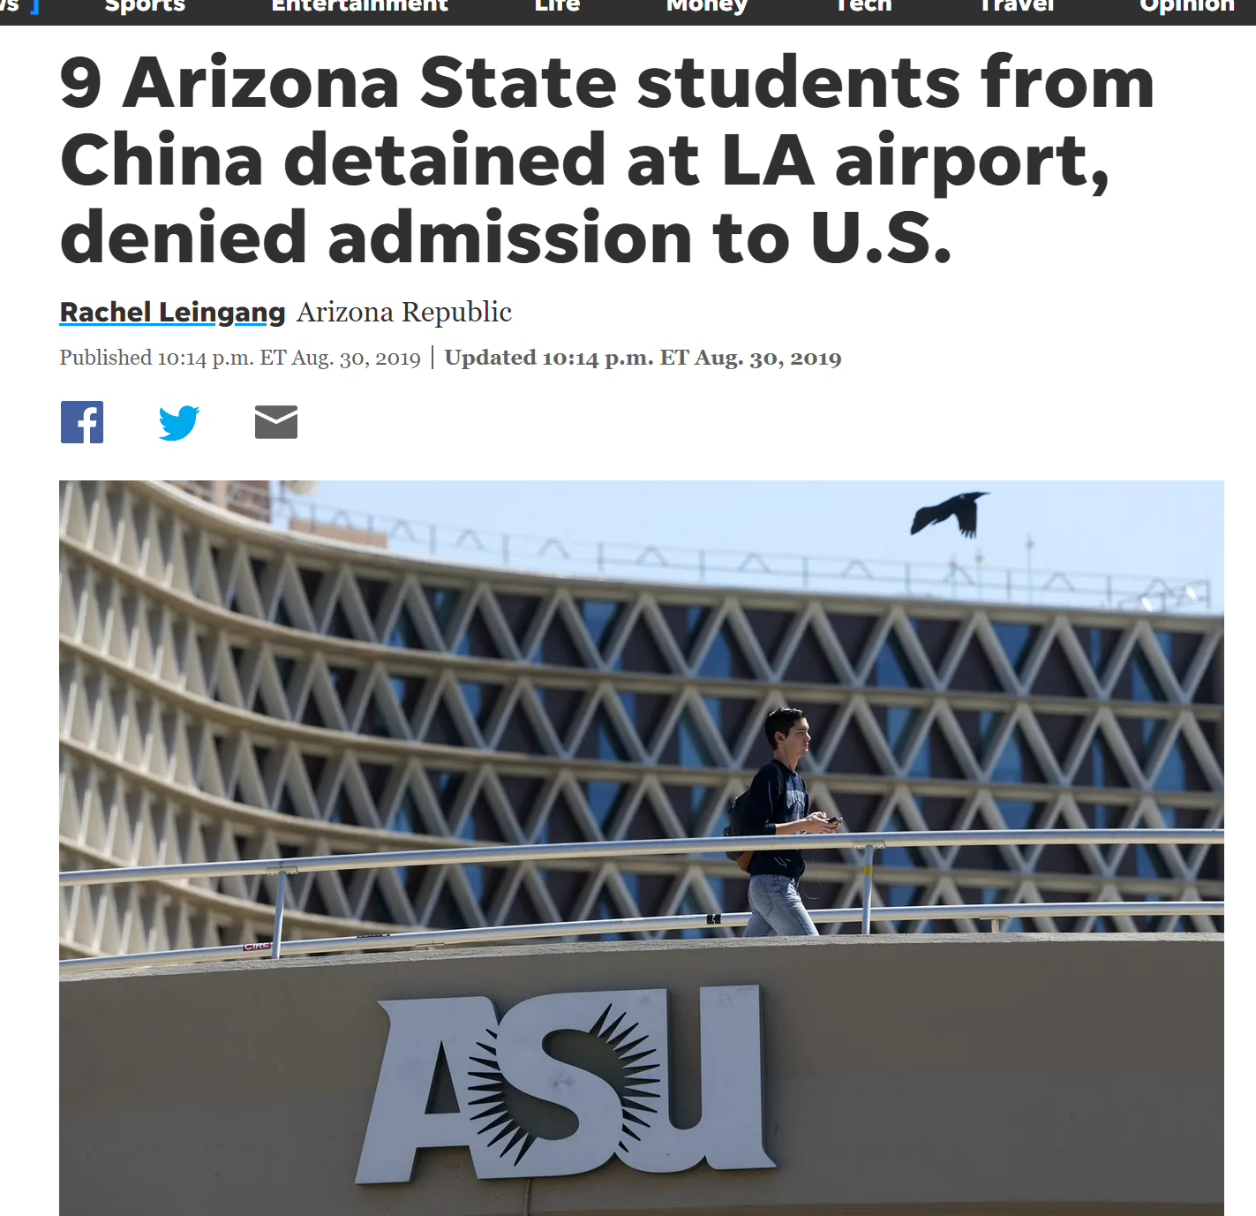
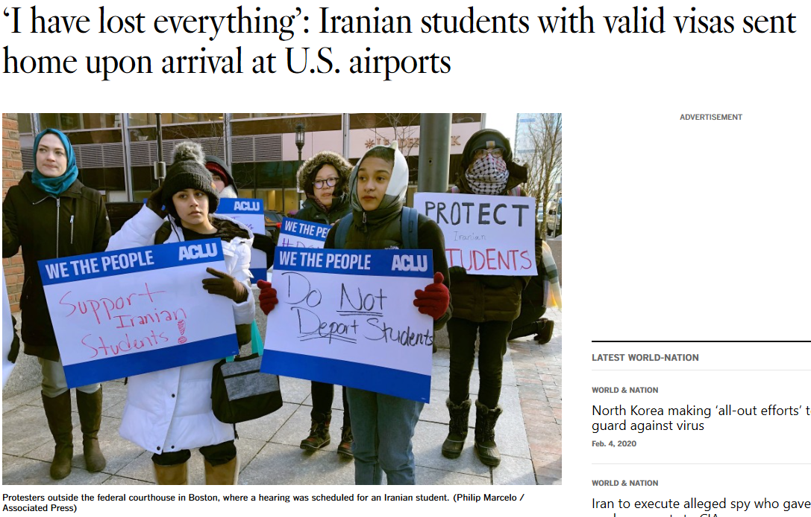
Student/ VISA Issues

Slide 43
Institutional challenges

Slide 44
Roles and Responsibilities
How does an institution know for sure what its investigators are involved in?
How “connected” are (or should) your internal systems be for managing sponsored projects, COIs, and COCs?
What can (should) an AOR attest to in terms of accuracy and completeness?
What are appropriate enforcement actions for violations?
  Determination of purposeful intent to mislead?
  Honest mistake?

Slide 45
Polling Questions:
What is your single greatest concern related to managing Foreign Influence Risk:
  Faculty Awareness & Understanding
  Leadership Support (Resources, Messaging, etc.)
  Clarity of sponsor regulations & definitions
  Overall ability to “Connect the Dots” for accurate reporting
  Institutional accountability for activities that only the faculty are aware of (e.g. Biosketch accuracy, Reporting of consulting/outside activities)

Slide 46
Managing the “Lists”
OFCCP Debarred Companies
DOD Releases List of Additional Companies, in Accordance with Section 1237 of FY99 NDAA
Australian Strategic Policy Institute (ASPI),
NDAA Section 889(a)(1)(B)
  5 companies “or by an entity “owned or controlled by, or otherwise connected to, the government of The People’s Republic of China.”

Slide 47
Department of Education Section 117 Reporting
Requires semi-annual reporting (30 days after reporting period end) of foreign gifts, grants and contracts exceeding $250K per year
Most recent changes
  New on-line reporting portal with no bulk data upload
  Need to report transactions from “affiliated” entities
  Requires submission of donor names (although Ed does not currently plan to release these)
  Increases the # of data elements that has to be reported
  Need to determine if a sponsor/donor is “foreign controlled”
First report under the new rules took Minnesota 250+ staff hours and took Duke ~200+ staff hours.

Slide 48

COMING
ATTRACTIONS

Slide 49
OSTP – JCORE Report and Actions
OSTP clearly defines the foreign influence problem
OSTP establishes harmonized actions for agencies
OSTP releases “best practice” for universities
OSTP: Office of Science & Technology Policy
JCORE: Joint Committee on the Research Environment – White House Summit
JASON Report: Fundamental Research Security
Kelvin Droegemeier
speech for the FDP on
June 23, 2020
Coming soon (now +- 6 mos)

Slide 50
Forthcoming NIH Changes
Biosketch
  Minimize duplication of Other Support;
  Update Section B to capture all scientific appointments;
  Remove Section D – Research support which duplicates “Other Support”
Clarification of Definitions
  Gifts, current and pending support, expectation for reporting in-kind resources
New Other Support Format
  Similar to NSF, will include structured format including for in-kind contributions
2020 NIH VIRTUAL SEMINAR ON PROGRAM FUNDING AND GRANTS ADMINISTRATION (10/27 – 10/29/20)

Slide 51
Dept. of Ed Section 117 Reporting
Expecting to see an NPRM that adds in an obligation to upload “true copies” of gifts, awards, licenses, etc.

Slide 52
Polling Question
If the Dept. of Ed does require “true” (unredacted) copies of gifts, awards, licenses, and other documents, what do you see as the SINGLE largest problem for your institution?
May deter donors who wish to remain anonymous
Logistics and resource constraints associated with trying to manage collection and uploading of all those documents
May deter agencies who wish to keep the contents of their awards or technology licensing agreements confidential
Logistics of trying to manage collection and uploading of all those documents
Something else not named on this list

Slide 53
Stay Aware: Key Recent Reading & Opportunities
  FBI Public Service Announcement on Foreign Talent Recruitment Programs https://asce.tamus.edu/wp-content/uploads/2020/07/psa-talent-programs.pdf
  Kelvin Droegemeier’s (OSTP Director) presentation entitled Enhancing the Security and Integrity of America's Research Enterprise https://www.whitehouse.gov/wp-content/uploads/2017/12/Enhancing-the-Security-and-Integrity-of-Americas-Research-Enterprise-June-2020.pdf
  NIH webpage Protecting US Biomedical Intellectual Innovation (includes chart for what to report for senior/key personnel): https://grants.nih.gov/policy/protecting-innovation.htm

Slide 54
Stay Aware: Key Recent Reading & Opportunities
  NIH Deputy Director Michael Lauer’s Blog (July 8) https://nexus.od.nih.gov/all/2020/07/08/addressing-foreign-interference-and-associated-risks-to-the-integrity-of-biomedical-research-and-how-you-can-help/
    Includes additional recommended reading
  2020 NIH Virtual Seminar
  NSF Seminar

Slide 55



